Slide 1
Python

Slide 2
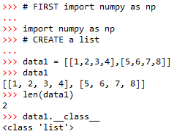
Create a list

Slide 3
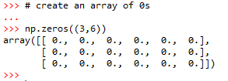
Array of zeros

Slide 4
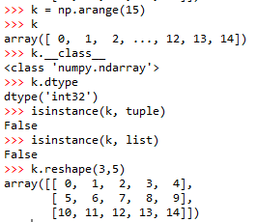

Make an array of 3 by 5 dimension of first 15 numbers (including 0)

Slide 5

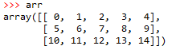
Transpose of array

Slide 6

Square Root

Slide 7
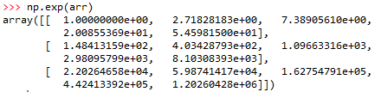
Exponential of array

Slide 8
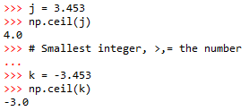

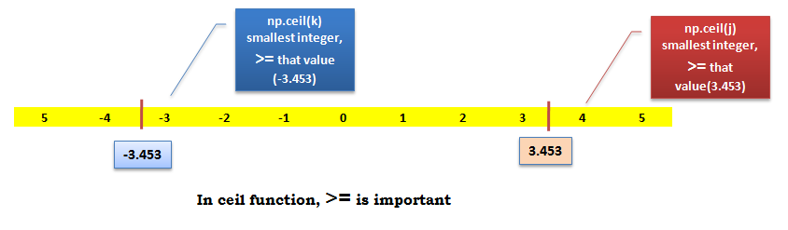
ceil

Slide 9

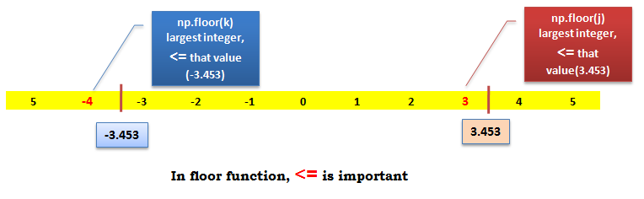
floor

Slide 10
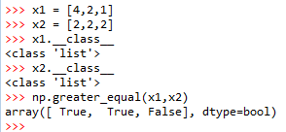
np.greater_equal

Slide 11
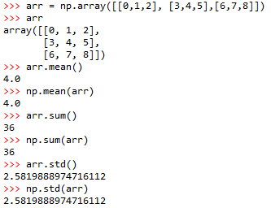
Sum, mean, SD

Slide 12
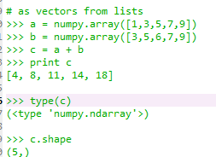
Numpy – Creating vectors
From lists
numpy.array

Slide 13
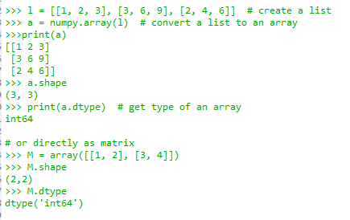
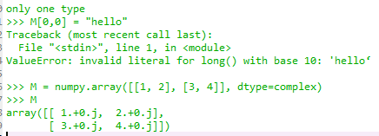
Numpy – Creating matrices

Slide 14
Numpy – Matrices use
>>> print(a)
[[1 2 3]
[3 6 9]
[2 4 6]]
>>> print(a[0]) # this is just like a list of lists
[1 2 3]
>>> print(a[1, 2]) # arrays can be given comma separated indices
9
>>> print(a[1, 1:3]) # and slices
[6 9]
>>> print(a[:,1])
[2 6 4]
>>> a[1, 2] = 7
>>> print(a)
[[1 2 3]
[3 6 7]
[2 4 6]]
>>> a[:, 0] = [0, 9, 8]
>>> print(a)
[[0 2 3]
[9 6 7]
[8 4 6]]

Slide 15
Numpy – Creating arrays
Generation functions
>>> x = arange(0, 10, 1) # arguments: start, stop, step
>>> x
array([0, 1, 2, 3, 4, 5, 6, 7, 8, 9])
>>> numpy.linspace(0, 10, 25)
array([ 0. , 0.41666667, 0.83333333, 1.25 ,
1.66666667, 2.08333333, 2.5 , 2.91666667,
3.33333333, 3.75 , 4.16666667, 4.58333333,
5. , 5.41666667, 5.83333333, 6.25 ,
6.66666667, 7.08333333, 7.5 , 7.91666667,
8.33333333, 8.75 , 9.16666667, 9.58333333, 10. ])
>>> numpy.logspace(0, 10, 10, base=numpy.e)
array([ 1.00000000e+00, 3.03773178e+00, 9.22781435e+00,
2.80316249e+01, 8.51525577e+01, 2.58670631e+02,
7.85771994e+02, 2.38696456e+03, 7.25095809e+03,
2.20264658e+04])

Slide 16
Numpy – Creating arrays
# a diagonal matrix
>>> numpy.diag([1,2,3])
array([[1, 0, 0],
[0, 2, 0],
[0, 0, 3]])
>>> b = numpy.zeros(5)
>>> print(b)
[ 0. 0. 0. 0. 0.]
>>> b.dtype
dtype(‘float64’)
>>> n = 1000
>>> my_int_array = numpy.zeros(n, dtype=numpy.int)
>>> my_int_array.dtype
dtype(‘int32’)
>>> c = numpy.ones((3,3))
>>> c
array([[ 1., 1., 1.],
[ 1., 1., 1.],
[ 1., 1., 1.]])

Slide 17
Numpy – array creation and use
>>> d = numpy.arange(5) # just like range()
>>> print(d)
[0 1 2 3 4]
>>> d[1] = 9.7
>>> print(d) # arrays keep their type even if elements changed
[0 9 2 3 4]
>>> print(d*0.4) # operations create a new array, with new type
[ 0. 3.6 0.8 1.2 1.6]
>>> d = numpy.arange(5, dtype=numpy.float)
>>> print(d)
[ 0. 1. 2. 3. 4.]
>>> numpy.arange(3, 7, 0.5) # arbitrary start, stop and step
array([ 3. , 3.5, 4. , 4.5, 5. , 5.5, 6. , 6.5])

Slide 18
Numpy – array creation and use
>>> x, y = numpy.mgrid[0:5, 0:5] # similar to meshgrid in MATLAB
>>> x
array([[0, 0, 0, 0, 0],
[1, 1, 1, 1, 1],
[2, 2, 2, 2, 2],
[3, 3, 3, 3, 3],
[4, 4, 4, 4, 4]])
# random data
>>> numpy.random.rand(5,5)
array([[ 0.51531133, 0.74085206, 0.99570623, 0.97064334, 0.5819413 ],
[ 0.2105685 , 0.86289893, 0.13404438, 0.77967281, 0.78480563],
[ 0.62687607, 0.51112285, 0.18374991, 0.2582663 , 0.58475672],
[ 0.72768256, 0.08885194, 0.69519174, 0.16049876, 0.34557215],
[ 0.93724333, 0.17407127, 0.1237831 , 0.96840203, 0.52790012]])

Slide 19
Numpy – Creating arrays
>>> os.system('head DeBilt.txt')
"Stn", "Datum", "Tg", "qTg", "Tn", "qTn", "Tx", "qTx"
001, 19010101, -49, 00, -68, 00, -22, 40
001, 19010102, -21, 00, -36, 30, -13, 30
001, 19010103, -28, 00, -79, 30, -5, 20
001, 19010104, -64, 00, -91, 20, -10, 00
001, 19010105, -59, 00, -84, 30, -18, 00
001, 19010106, -99, 00, -115, 30, -78, 30
001, 19010107, -91, 00, -122, 00, -66, 00
001, 19010108, -49, 00, -94, 00, -6, 00
001, 19010109, 11, 00, -27, 40, 42, 00
0
>>> data = numpy.genfromtxt('DeBilt.txt‘, delimiter=',‘, skip_header=1)
>>> data.shape
(25568, 8)
>>> numpy.savetxt('datasaved.txt', data)
>>> os.system('head datasaved.txt')
1.000000000000000000e+00 1.901010100000000000e+07 -4.900000000000000000e+01 0.000000000000000000e+00 -6.800000000000000000e+01 0.000000000000000000e+00 -2.200000000000000000e+01 4.000000000000000000e+01
1.000000000000000000e+00 1.901010200000000000e+07 -2.100000000000000000e+01 0.000000000000000000e+00 -3.600000000000000000e+01 3.000000000000000000e+01 -1.300000000000000000e+01 3.000000000000000000e+01
1.000000000000000000e+00 1.901010300000000000e+07 -2.800000000000000000e+01 0.000000000000000000e+00 -7.900000000000000000e+01 3.000000000000000000e+01 -5.000000000000000000e+00 2.000000000000000000e+01

Slide 20
Numpy – Creating arrays
>>> M = numpy.random.rand(3,3)
>>> M
array([[ 0.84188778, 0.70928643, 0.87321035],
[ 0.81885553, 0.92208501, 0.873464 ],
[ 0.27111984, 0.82213106, 0.55987325]])
>>>
>>> numpy.save('saved-matrix.npy', M)
>>> numpy.load('saved-matrix.npy')
array([[ 0.84188778, 0.70928643, 0.87321035],
[ 0.81885553, 0.92208501, 0.873464 ],
[ 0.27111984, 0.82213106, 0.55987325]])
>>>
>>> os.system('head saved-matrix.npy')
NUMPYF{'descr': '<f8', 'fortran_order': False, 'shape': (3, 3), }
Ï<
£¾ðê?­sy²æ?$÷ÒVñë?Ù4ê?%dn¸í?Ã[Äjóë?Ä,ZÑ?Ç
ÎåNê?ó7L{êá?0
>>>

Slide 21
Numpy – ndarray attributes
ndarray.ndim
the number of axes (dimensions) of the array i.e. the rank.
ndarray.shape
the dimensions of the array. This is a tuple of integers indicating the size of the array in each dimension. For a matrix with n rows and m columns, shape will be (n,m). The length of the shape tuple is therefore the rank, or number of dimensions, ndim.
ndarray.size
the total number of elements of the array, equal to the product of the elements of shape.
ndarray.dtype
an object describing the type of the elements in the array. One can create or specify dtype's using standard Python types. NumPy provides many, for example bool_, character, int_, int8, int16, int32, int64, float_, float8, float16, float32, float64, complex_, complex64, object_.
ndarray.itemsize
the size in bytes of each element of the array. E.g. for elements of type float64, itemsize is 8 (=64/8), while complex32 has itemsize 4 (=32/8) (equivalent to ndarray.dtype.itemsize).
ndarray.data
the buffer containing the actual elements of the array. Normally, we won't need to use this attribute because we will access the elements in an array using indexing facilities.

Slide 22
Numpy – array creation and use
Two ndarrays are mutable and may be views to the same memory:
>>> x = np.array([1,2,3,4])
>>> y = x
>>> x is y
True
>>> id(x), id(y)
(139814289111920, 139814289111920)
>>> x[0] = 9
>>> y
array([9, 2, 3, 4])
>>> x[0] = 1
>>> z = x[:]
>>> x is z
False
>>> id(x), id(z)
(139814289111920, 139814289112080)
>>> x[0] = 8
>>> z
array([8, 2, 3, 4])
>>> x = np.array([1,2,3,4])
>>> y = x.copy()
>>> x is y
False
>>> id(x), id(y)
(139814289111920, 139814289111840)
>>> x[0] = 9
>>> x
array([9, 2, 3, 4])
>>> y
array([1, 2, 3, 4])

Slide 23
Numpy – array creation and use
>>> a = numpy.arange(4.0)
>>> b = a * 23.4
>>> c = b/(a+1)
>>> c += 10
>>> print c
[ 10. 21.7 25.6 27.55]
>>> arr = numpy.arange(100, 200)
>>> select = [5, 25, 50, 75, -5]
>>> print(arr[select]) # can use integer lists as indices
[105, 125, 150, 175, 195]
>>> arr = numpy.arange(10, 20 )
>>> div_by_3 = arr%3 == 0 # comparison produces boolean array
>>> print(div_by_3)
[ False False True False False True False False True False]
>>> print(arr[div_by_3]) # can use boolean lists as indices
[12 15 18]
>>> arr = numpy.arange(10, 20) . reshape((2,5))
[[10 11 12 13 14]
[15 16 17 18 19]]

Slide 24
Numpy – array methods
>>> arr.sum()
145
>>> arr.mean()
14.5
>>> arr.std()
2.8722813232690143
>>> arr.max()
19
>>> arr.min()
10
>>> div_by_3.all()
False
>>> div_by_3.any()
True
>>> div_by_3.sum()
3
>>> div_by_3.nonzero()
(array([2, 5, 8]),)

Slide 25
Numpy – array methods - sorting
>>> arr = numpy.array([4.5, 2.3, 6.7, 1.2, 1.8, 5.5])
>>> arr.sort() # acts on array itself
>>> print(arr)
[ 1.2 1.8 2.3 4.5 5.5 6.7]
>>> x = numpy.array([4.5, 2.3, 6.7, 1.2, 1.8, 5.5])
>>> numpy.sort(x)
array([ 1.2, 1.8, 2.3, 4.5, 5.5, 6.7])
>>> print(x)
[ 4.5 2.3 6.7 1.2 1.8 5.5]
>>> s = x.argsort()
>>> s
array([3, 4, 1, 0, 5, 2])
>>> x[s]
array([ 1.2, 1.8, 2.3, 4.5, 5.5, 6.7])
>>> y[s]
array([ 6.2, 7.8, 2.3, 1.5, 8.5, 4.7])

Slide 26
Numpy – array functions
Most array methods have equivalent functions
>>> arr.sum()
45
>>> numpy.sum(arr)
45
Ufuncs provide many element-by-element math, trig., etc. operations
e.g., add(x1, x2), absolute(x), log10(x), sin(x), logical_and(x1, x2)
See http://numpy.scipy.org

Slide 27
Numpy – array operations
>>> a = array([[1.0, 2.0], [4.0, 3.0]])
>>> print a
[[ 1. 2.]
[ 3. 4.]]
>>> a.transpose()
array([[ 1., 3.],
[ 2., 4.]])
>>> inv(a)
array([[-2. , 1. ],
[ 1.5, -0.5]])
>>> u = eye(2) # unit 2x2 matrix; "eye" represents "I"
>>> u
array([[ 1., 0.],
[ 0., 1.]])
>>> j = array([[0.0, -1.0], [1.0, 0.0]])
>>> dot (j, j) # matrix product
array([[-1., 0.],
[ 0., -1.]])
Notes:
27

Slide 28
Numpy – statistics
In addition to the mean, var, and std functions, NumPy supplies several other methods for returning statistical features of arrays. The median can be found:
>>> a = np.array([1, 4, 3, 8, 9, 2, 3], float)
>>> np.median(a)
3.0
The correlation coefficient for multiple variables observed at multiple instances can be found for arrays of the form [[x1, x2, …], [y1, y2, …], [z1, z2, …], …] where x, y, z are different observables and the numbers indicate the observation times:
>>> a = np.array([[1, 2, 1, 3], [5, 3, 1, 8]], float)
>>> c = np.corrcoef(a)
>>> c
array([[ 1. , 0.72870505],
[ 0.72870505, 1. ]])
Here the return array c[i,j] gives the correlation coefficient for the ith and jth observables. Similarly, the covariance for data can be found::
>>> np.cov(a)
array([[ 0.91666667, 2.08333333],
[ 2.08333333, 8.91666667]])
Notes:
28

Slide 29
Using arrays wisely
Array operations are implemented in C or Fortran
Optimised algorithms - i.e. fast!
Python loops (i.e. for i in a:…) are much slower
Prefer array operations over loops, especially when speed important
Also produces shorter code, often more readable

Slide 30
Numpy – arrays, matrices
For two dimensional arrays NumPy defined a special matrix class in module matrix. Objects are created either with matrix() or mat() or converted from an array with method asmatrix().
>>> import numpy
>>> m = numpy.mat([[1,2],[3,4]])
or
>>> a = numpy.array([[1,2],[3,4]])
>>> m = numpy.mat(a)
or
>>> a = numpy.array([[1,2],[3,4]])
>>> m = numpy.asmatrix(a)
Note that the statement m = mat(a) creates a copy of array 'a'.
Changing values in 'a' will not affect 'm'.
On the other hand, method m = asmatrix(a) returns a new reference to the same data.
Changing values in 'a' will affect matrix 'm'.
Notes:
30

Slide 31
Numpy – matrices
Array and matrix operations may be quite different!
>>> a = array([[1,2],[3,4]])
>>> m = mat(a) # convert 2-d array to matrix
>>> m = matrix([[1, 2], [3, 4]])
>>> a[0] # result is 1-dimensional
array([1, 2])
>>> m[0] # result is 2-dimensional
matrix([[1, 2]])
>>> a*a # element-by-element multiplication
array([[ 1, 4], [ 9, 16]])
>>> m*m # (algebraic) matrix multiplication
matrix([[ 7, 10], [15, 22]])
>>> a**3 # element-wise power
array([[ 1, 8], [27, 64]])
>>> m**3 # matrix multiplication m*m*m
matrix([[ 37, 54], [ 81, 118]])
>>> m.T # transpose of the matrix
matrix([[1, 3], [2, 4]])
>>> m.H # conjugate transpose (differs from .T for complex matrices)
matrix([[1, 3], [2, 4]])
>>> m.I # inverse matrix
matrix([[-2. , 1. ], [ 1.5, -0.5]])
Notes:
31

Slide 32
Numpy – matrices
Operator *, dot(), and multiply():
For array, '*' means element-wise multiplication, and the dot() function is used for matrix multiplication.
For matrix, '*'means matrix multiplication, and the multiply() function is used for element-wise multiplication.
Handling of vectors (rank-1 arrays)
For array, the vector shapes 1xN, Nx1, and N are all different things. Operations like A[:,1] return a rank-1 array of shape N, not a rank-2 of shape Nx1. Transpose on a rank-1 array does nothing.
For matrix, rank-1 arrays are always upgraded to 1xN or Nx1 matrices (row or column vectors). A[:,1] returns a rank-2 matrix of shape Nx1.
Handling of higher-rank arrays (rank > 2)
array objects can have rank > 2.
matrix objects always have exactly rank 2.
Convenience attributes
array has a .T attribute, which returns the transpose of the data.
matrix also has .H, .I, and .A attributes, which return the conjugate transpose, inverse, and asarray() of the matrix, respectively.
Convenience constructor
The array constructor takes (nested) Python sequences as initializers. As in array([[1,2,3],[4,5,6]]).
The matrix constructor additionally takes a convenient string initializer. As in matrix("[1 2 3; 4 5 6]")
Notes:
32

Slide 33
Numpy – array mathematics
>>> a = np.array([1,2,3], float)
>>> b = np.array([5,2,6], float)
>>> a + b
array([6., 4., 9.])
>>> a – b
array([-4., 0., -3.])
>>> a * b
array([5., 4., 18.])
>>> b / a
array([5., 1., 2.])
>>> a % b
array([1., 0., 3.])
>>> b**a
array([5., 4., 216.])
>>> a = np.array([[1, 2], [3, 4], [5, 6]], float)
>>> b = np.array([-1, 3], float)
>>> a
array([[ 1., 2.],
[ 3., 4.],
[ 5., 6.]])
>>> b
array([-1., 3.])
>>> a + b
array([[ 0., 5.],
[ 2., 7.],
[ 4., 9.]])
>>> a = np.array([[1, 2], [3, 4], [5, 6]], float)
>>> b = np.array([-1, 3], float)
>>> a * a
array([[ 1., 4.],
[ 9., 16.],
[ 25., 36.]])
>>> b * b
array([ 1., 9.])
>>> a * b
array([[ -1., 6.],
[ -3., 12.],
[ -5., 18.]])
>>>
Notes:
33

Slide 34
Numpy – array mathematics
>>> A = np.array([[n+m*10 for n in range(5)] for m in range(5)])
>>> v1 = arange(0, 5)
>>> A
array([[ 0, 1, 2, 3, 4],
[10, 11, 12, 13, 14],
[20, 21, 22, 23, 24],
[30, 31, 32, 33, 34],
[40, 41, 42, 43, 44]])
>>> v1
array([0, 1, 2, 3, 4])
>>> np.dot(A,A)
array([[ 300, 310, 320, 330, 340],
[1300, 1360, 1420, 1480, 1540],
[2300, 2410, 2520, 2630, 2740],
[3300, 3460, 3620, 3780, 3940],
[4300, 4510, 4720, 4930, 5140]])
>>>
>>> np.dot(A,v1)
array([ 30, 130, 230, 330, 430])
>>> np.dot(v1,v1)
30
>>>
Alternatively, we can cast the array objects to the type matrix. This changes the behavior of the standard arithmetic operators +, -, * to use matrix algebra.
>>> M = np.matrix(A)
>>> v = np.matrix(v1).T
>>> v
matrix([[0],
[1],
[2],
[3],
[4]])
>>> M*v
matrix([[ 30],
[130],
[230],
[330],
[430]])
>>> v.T * v # inner product
matrix([[30]])
# standard matrix algebra applies
>>> v + M*v
matrix([[ 30],
[131],
[232],
[333],
[434]])
Notes:
34

